Slide 1
MAR 580: Advanced Population Modeling for Management of Living Marine Resources
Lecture 1b
Introduction to programming, why ADMB?
www.mycourses.umassd.edu
(Acknowledgements: André Punt, Anders Nielsen)
1 September 2015

Slide 2
Today’s Outline
Introduction to programming, why ADMB?
Lab exercise: Linear modeling using ADMB

Slide 3
Model Building, Using, Developing
In the fisheries resource assessment world, typically three types of user:
Model user: take canned software and press go, limited understanding of what is happening under the hood.
Model builder: can use existing software to build alternative models, fit to new data sets, etc.
Model developer: someone who is interested in developing and testing code underlying model structure and performance.
The aim of this class is to provide you with the skill set to work toward the second two of these, hopefully you are interested in the third!

Slide 4
Models in fisheries, fitting to data
Common exercise in fisheries and wildlife science is fitting a model to some data.
These models (and the data they are fit to) can be simple to more complicated.
e.g. regressions, stock-recruitment analysis, population dynamics models, etc.
Optimization tools in statistical software (e.g. lm() or nls() in R) can be used in a lot of instances.
Custom-built objective functions can also be helpful (e.g. using optimize() in R ).
Sometimes these tools can be slow or unstable when our models contain lots of parameters or datasets become large.

Slide 5

What is AD Model Builder?
Put simply, it is a package to help conduct optimization (parameter estimation) of highly nonlinear models. It includes:
Tools for reading in most interesting data objects (number, vector, matrix, 3darray, ragged arrays, strings, ...)
Tools for specifying model parameters (unbounded, bounded, summing to zero, vectors of, matrix of, ...)
A simple way to set up optimization in phases.
Helpful functions (gammaln, choleski decomp, inv, …).
Calculations for measures of uncertainty by:
estimating asymptotic variance-covariance matrices,
computing likelihood profiles,
sampling parameter vectors from Bayesian posteriors using Markov Chain Monte Carlo (MCMC) algorithm.
capacity to deal very well with random effects (mixed effects) models. [Ask later about TMB…]

Slide 6
What is AD Model Builder?
Most statistical stock assessment software in use today are written in ADMB.
e.g. ASAP, Stock Synthesis, CASAL, etc.
With ADMB you write a template file that contains your model specification, and how the data relate to the model (objective function).
ADMB is fast because the minimization algorithm uses analytical derivatives and a quasi-Newton algorithm.
You need to specify the objective function, but ADMB takes care of the minimization procedure.
There is no need to supply the derivatives of the function to be minimized with respect to the parameters; these are computed automatically using Reverse Mode Autodifferentiation (the ‘AD’).

Slide 7
Types of programming languages
Generally fall in to one of two categories
Interpreted languages immediately execute commands.
Compiled languages are written in a code that can be executed directly on a computer’s processor. Compilers take your source code and turn it into object code that can be used by the processor, and create an executable that can run this code.

Slide 8
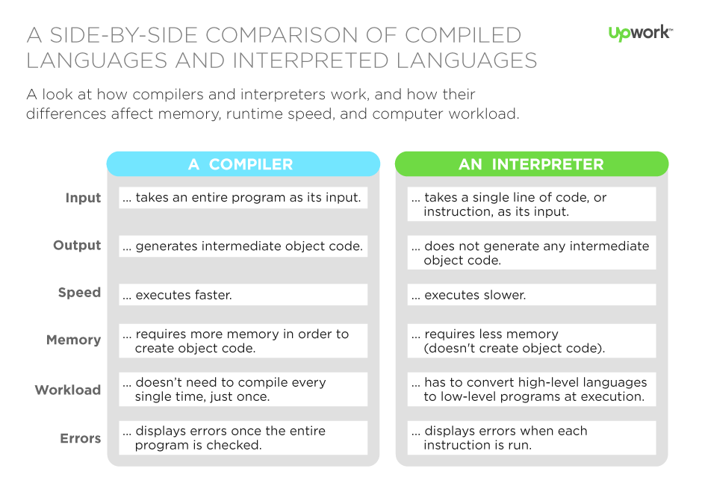
http://www.upwork.com

Slide 9
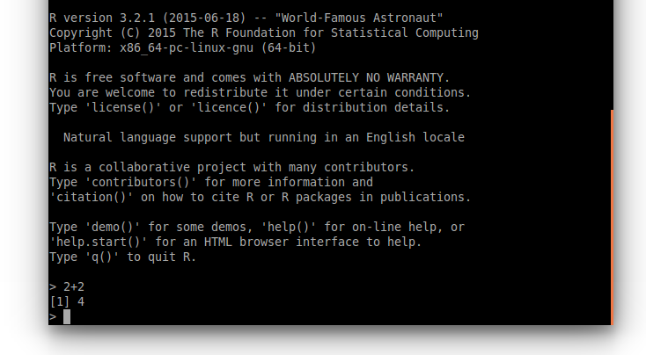
R is an example of an interpreted language.
Typing 2+2 into the command prompt gives the result instantly. The code is executed as it is parsed.

Slide 10
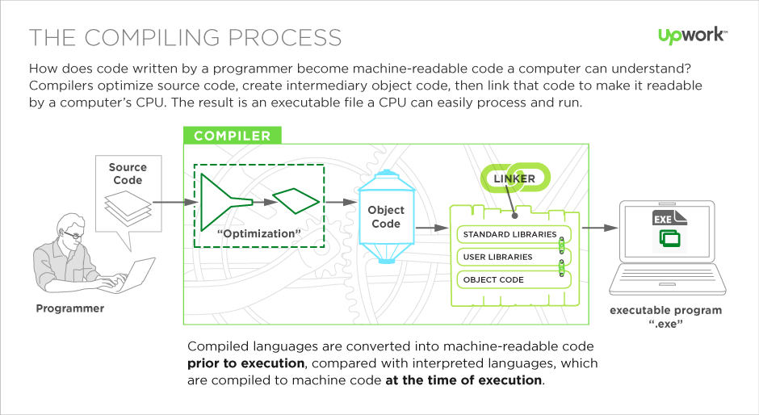
http://www.upwork.com

Slide 11
ADMB is a compiled language
In fact, it is a little different.
In ADMB you write an ADMB template (.tpl) file.
The compiler first turns this into C++ code, which is then compiled by a C++ compiler and linked to ADMB libraries to make the executable.

Slide 12
Specifying the Problem – the ADMB approach
ADMB programs are written using a template (a file with a .tpl extension).
The .tpl file specifies:
the data (constants) that are part of the function,
the parameters that are to be varied to minimize the function,
any variables that depend on the parameters but are not parameters themselves; and
the function to be minimized.
When in doubt, consult the ADMB documentation. Sometimes terse, but often useful.

Slide 13
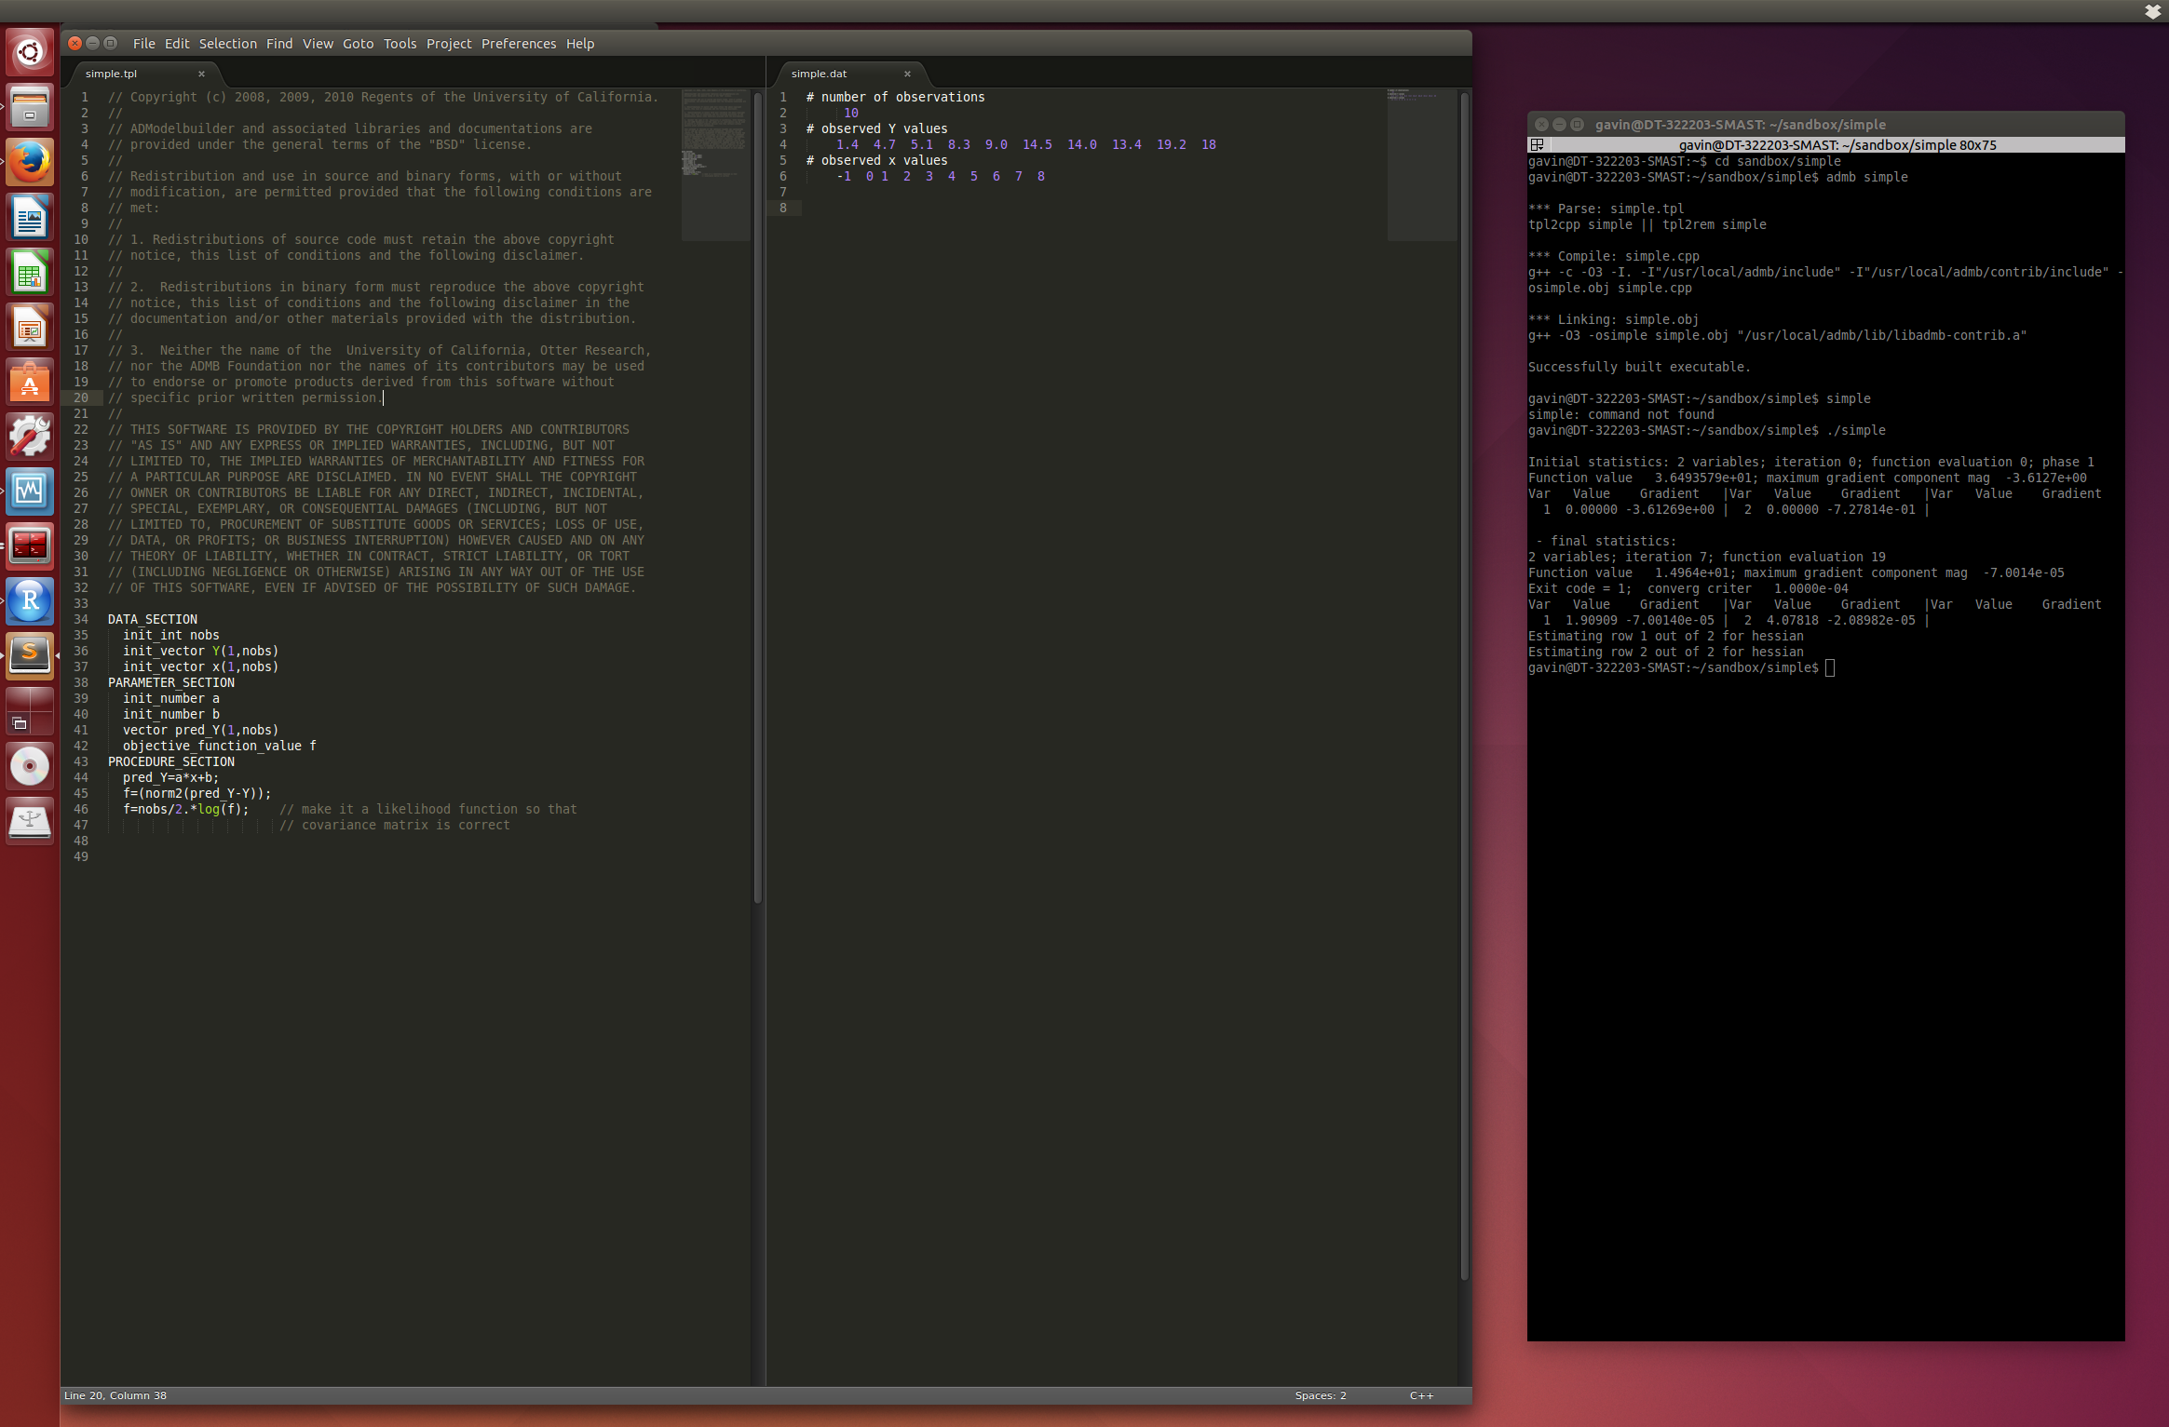
Work environment – text editor and shell
Text editor: write code, edit and view data and output files
Shell: compile code / build models, run models.

Slide 14
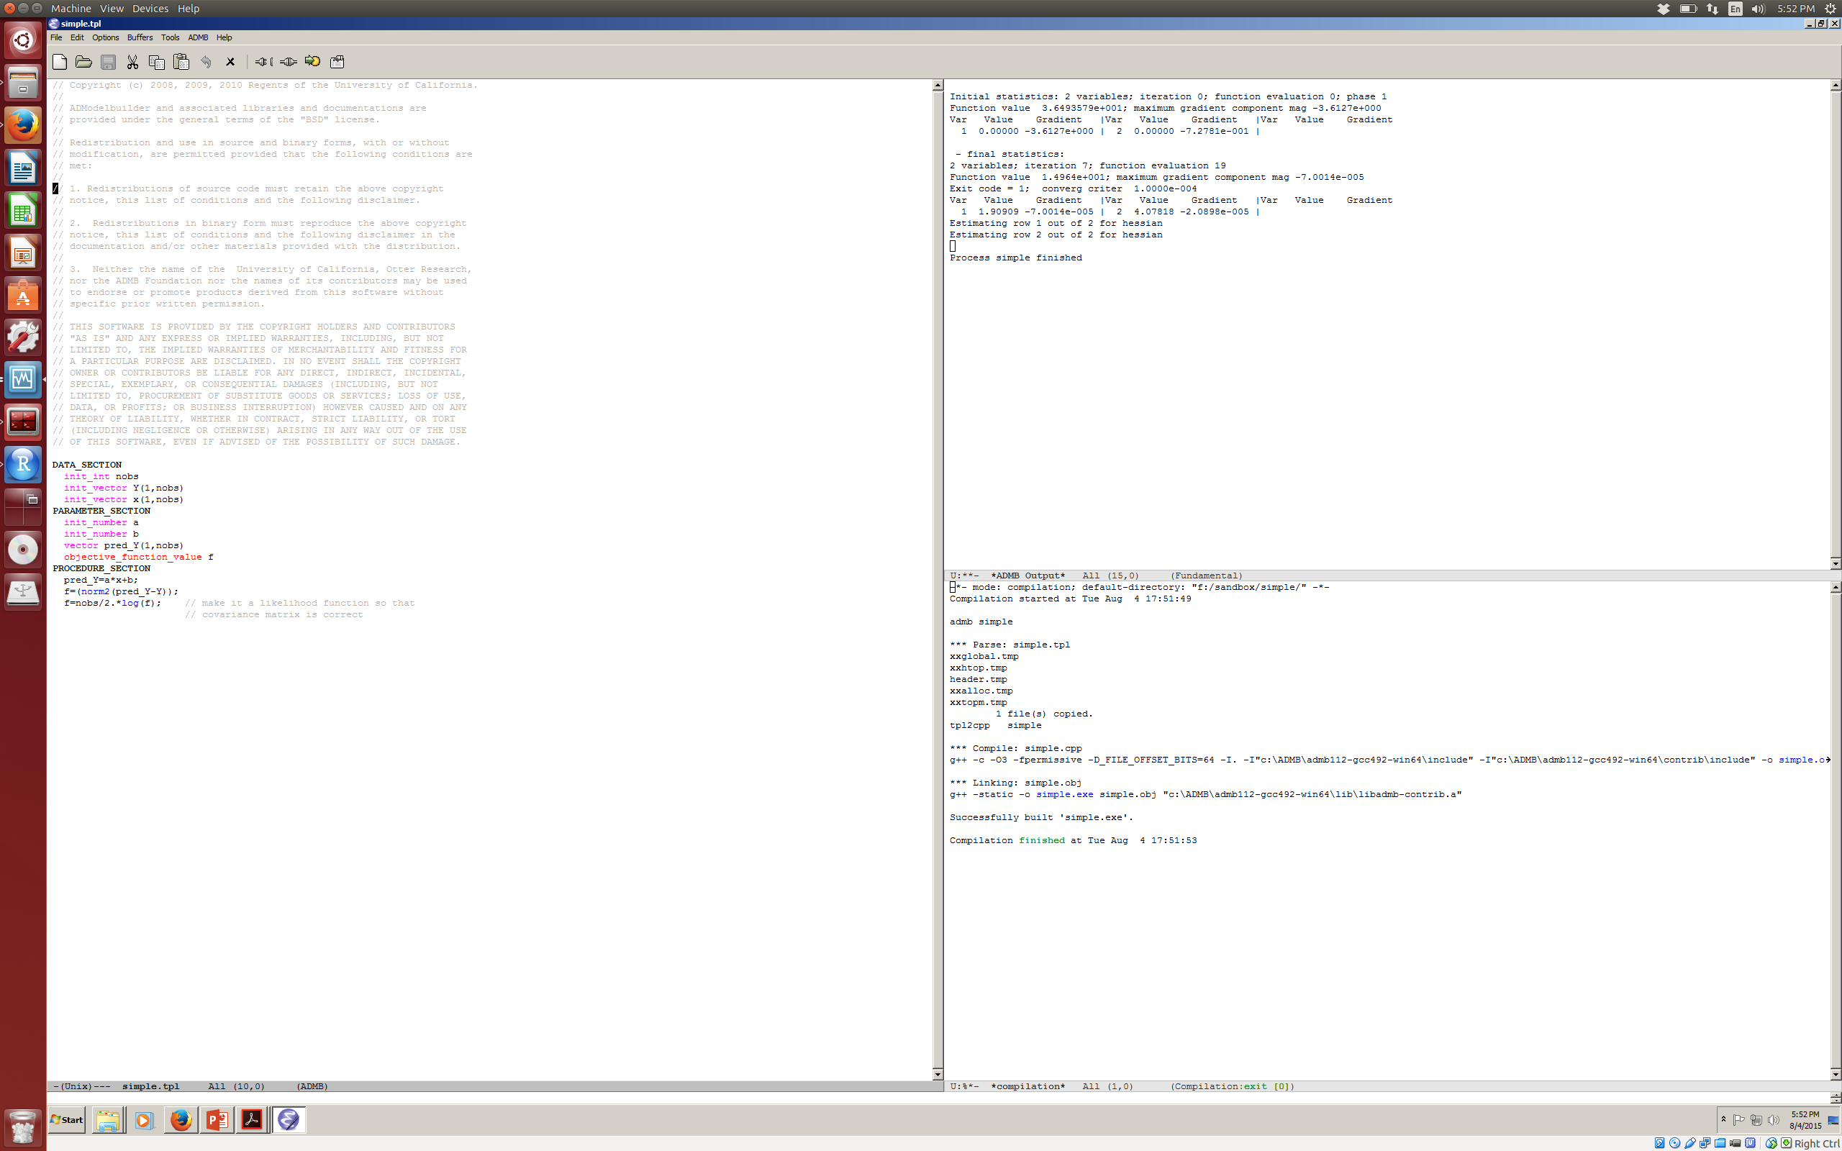
Work environment – ADMB-IDE
Results from running program.
.tpl file, write and edit code
Compile/Build code report.

Slide 15
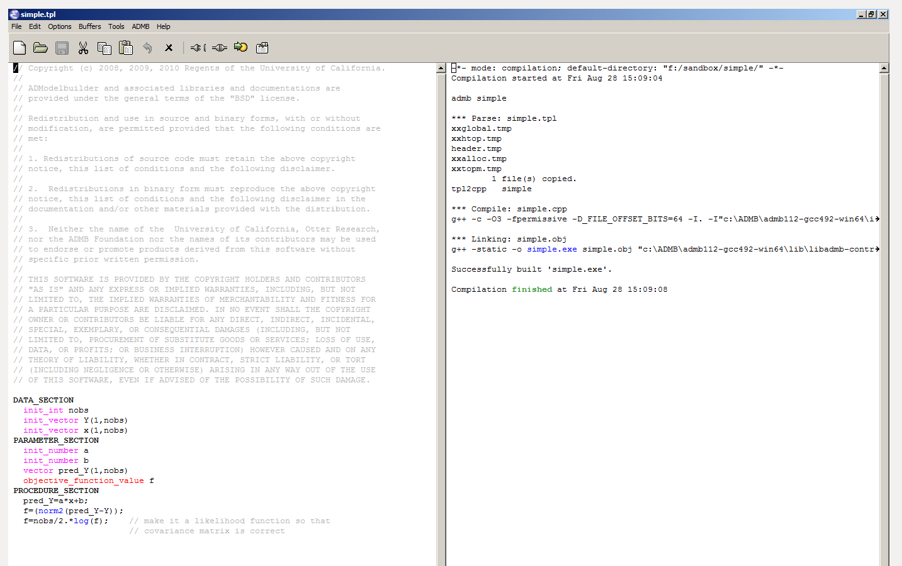
Compile .tpl to create executable.
Click to ‘Build’
Convert .tpl to C++
Call to the C++ compiler and linker.
Hooray!
In a shell (or DOS prompt):
cd to directory containing myprogram.tpl
Type: admb myprogram

Slide 16
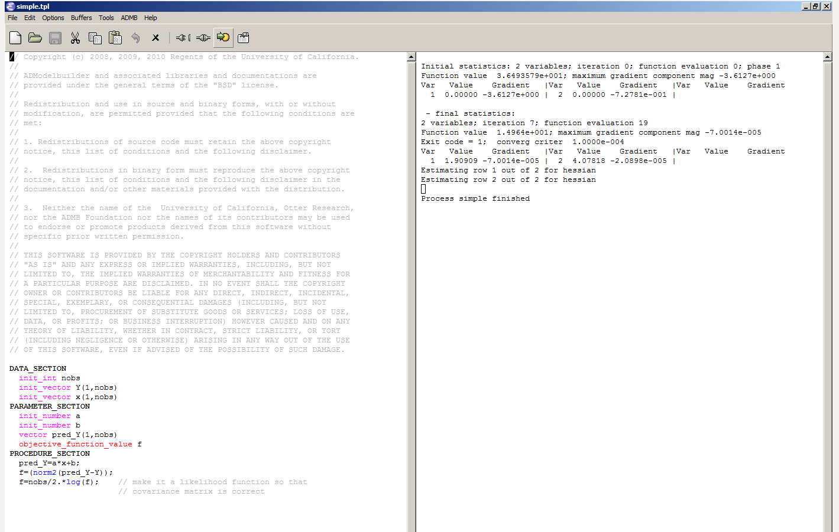
Running your executable (.dat file required)
Click to Run model.
Output while running the model.
In a shell (or DOS prompt):
Windows, type: myprogram Linux/Mac, type : ./myprogram

Slide 17
Example: Linear regression
Start with a least-squares linear regression:
Find a and b by minimizing:
Program: Lab1.tpl
Data File: Lab1.dat
To compile: admb Lab1
To run: Lab1 (or ./Lab1)
Have a look at the various output files.
(Lab1.par, Lab1.cor, Lab1.std)

Slide 18
Example (Linear Regression) .tpl file structure
Sections:
DATA –the input data (read from
Lab1.DAT)
PARAMETER – the model parameters, any
functions of the parameters, and the
objective function.
PROCEDURE – where the calculations are
done.
There are other SECTIONS which will come
later.
DATA_SECTION
init_int ndata;
init_vector x(1,ndata);
init_vector y(1,ndata);
PARAMETER_SECTION
init_number a;
init_number b;
vector ypred(1,ndata);
objective_function_value obj_fun;
PROCEDURE_SECTION
ypred = a + b*x;
obj_fun = norm2(y-ypred);

Slide 19
Example (Linear Regression) .tpl file structure
Reserved words:
To specify storage types (in blue)
To specify built-in functions (in green)
DATA_SECTION
init_int ndata;
init_vector x(1,ndata);
init_vector y(1,ndata);
PARAMETER_SECTION
init_number a;
init_number b;
vector ypred(1,ndata);
objective_function_value obj_fun;
PROCEDURE_SECTION
ypred = a + b*x;
obj_fun = norm2(y-ypred);
// This is a comment
catch is a reserved word!
Some notes:
You can add comments (lines starting with //) – use them!
ADMB works with vectors – see how
the predicted values are computed.
The “objective_function_value” is the
variable being minimized.

Slide 20
Example (Linear Regression) Adding Output
DATA_SECTION
init_int ndata;
init_vector x(1,ndata);
init_vector y(1,ndata);
PARAMETER_SECTION
init_number a;
init_number b;
vector ypred(1,ndata);
objective_function_value obj_fun;
PROCEDURE_SECTION
ypred = a + b*x;
cout << ypred << endl;
obj_fun = norm2(y-ypred);
// This is a comment
REPORT_SECTION
report << “y” << endl;
report << y << endl;
report << “ypred” << endl;
report << ypred << endl;
Use:
“cout” to output the values for variables to the screen; and
“report” to output results to the .REP file (only after the minimization is complete)

Slide 21
Example (Linear Regression) Output Files
Lab1.par – lists the parameter estimates, the final objective function, and the gradient – the latter should be close to zero!
Lab1.std – lists the parameter estimates and the (asymptotic) standard errors.
Lab1.cor – lists the parameter estimates, their (asymptotic) standard errors, and their (asymptotic) correlation matrix.
Lab1.rep – lists any variables specified in the REPORT_SECTION.

Slide 22
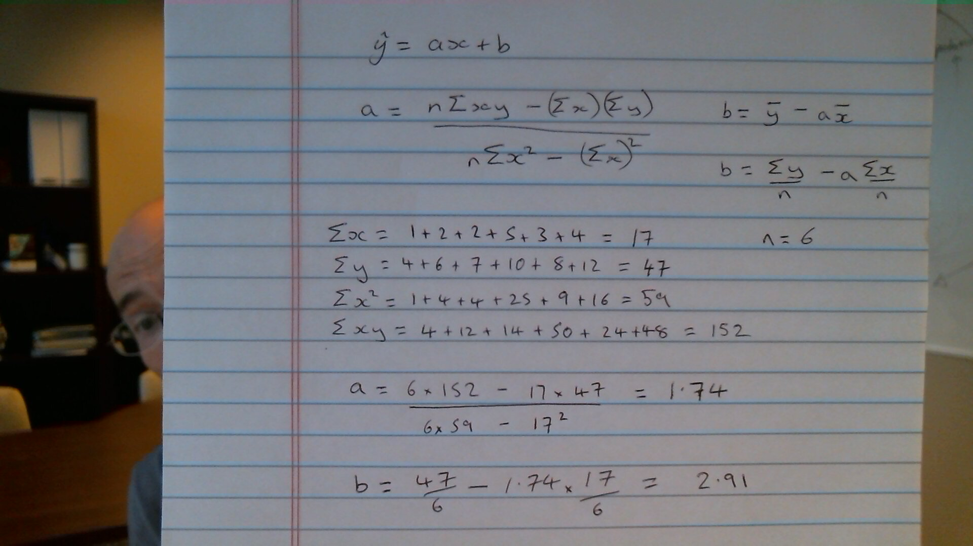
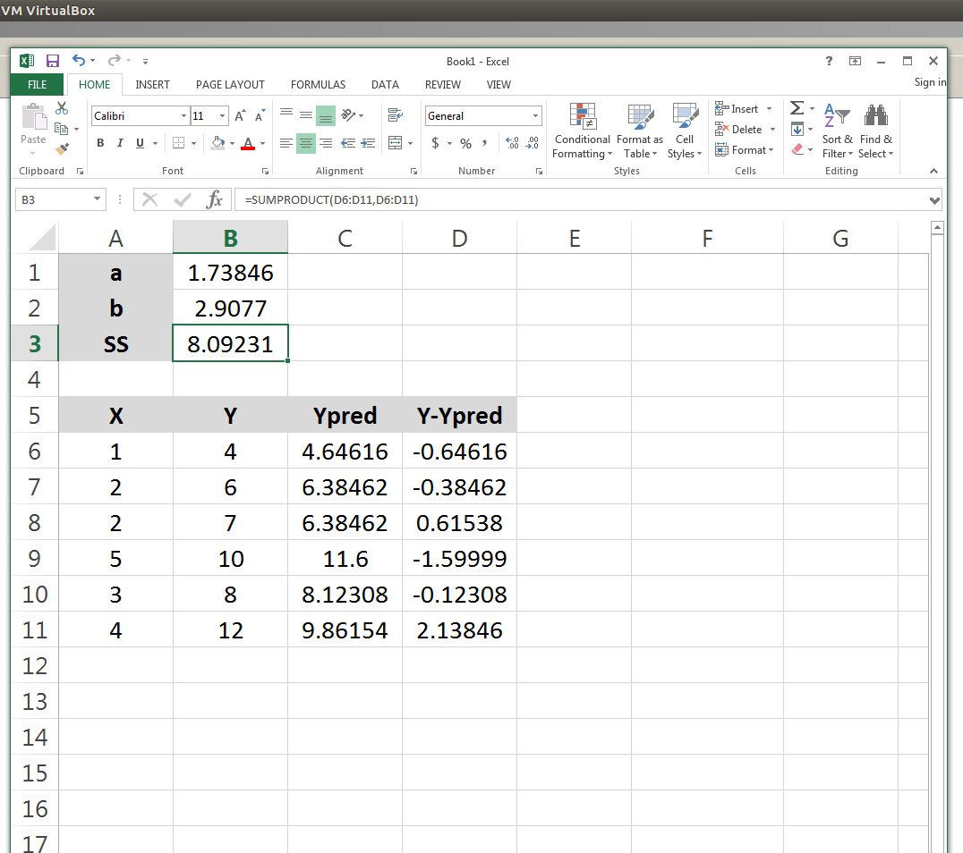
This problem could have been done by hand or in EXCEL using SOLVER (or using lm() in R, or…..)

Slide 23
Dissecting The Program (arithmetic)
ypred = a + b*x;
obj_fun = norm2(y-ypred);
The first line is a vector operation - it defines a vector, each element of which, ypred(i), is a+b*x(i).
The second line sums the squares of the differences between the observed (y) and predicted (ypred) values – this is also a vector operation.

Slide 24
Something About Arithmetic
The following are the ADMB arithmetic expressions:
Z=a+b //addition (note Z+=b)
Z=a-b //subtraction
Z=a*b //multiplication
Z=a/b //division
ADMB implements all the standard functions (and more):
Z=log(a) //log to the base e [ln]
Z=mfexp(a)
Z=pow(a,b) //exponentiation
Z=square(a)
Z=norm2(vec1)

Slide 25
Declaring Variables
Before a variable is used, it has to be declared.
Key distinction among variables:
Fixed throughout the program (data to be read in, values for fixed parameters): declare in the DATA_SECTION.
The parameters to be estimated and any variables that are functions of these parameters: declare in the PARAMETER_SECTION.
Declarations are of the form:
“Data type” “variable name”;

Slide 26
Data Types
ADMB needs to know what dimensions and format your data/variables/parameters will be in!
The most-basic types:
int (e.g. int Count) integer.
number (e.g. number Biomass) real number.
vector (e.g. vector me(1,10)), set of real numbers indexed by 1,2,..,10.
ivector as for vector, except that the contents are integers.
matrix (e.g. Weight(1,Nyear,1,Nage)) two dimensional array of real;
imatrix two dimensional array of integer;
3darray three dimensional array of real; and
4darray four dimensional array of real.
All variables MUST be declared before they are used – no exemptions!

Slide 27
Variable Names
Must start with an alphabetic character.
Don’t use any reserved words (if, else, etc.)
Choose descriptive but not overly long variable names (e.g. biomass, MSY).
ADMB (and C) is case-sensitive, i.e. the variables biomass and Biomass are NOT the same variable.
Other rules / hints:
Use underscores to split names within a variable name (e.g. my_biomass).
Avoid re-using the same variable for different purposes.
Don’t forget those semi-colons!

Slide 28
Programming the Procedure Section (The “if” statement)
All the normal C++ statements can be used in the Procedure Section.
The if statement:
if (condition)
Statements-1;
else
Statements-2;
Combining statements:
{ statement; statement; }

Slide 29
Programming the Procedure Section (Constructing conditions)
RELATIONAL OPERATORS:
== Equal to (NOT =)
<= Less than or equal to
>= Greater than or equal to
< Less than
> Greater than
!= Not equal to
LOGICAL OPERATORS:
&& Condition is true if both sub-conditions are true
|| Condition is true if one of the sub-conditions is true
! Condition is true if sub-condition is false
Note: ADMB may not work if a parameter or derived variable appears in a condition.

Slide 30
Programming the Procedure Section The “for” statement
for (initial state; terminal condition; increment)
{ statements; }
Initial state: Usually involves setting a “loop control variable” to some initial value.
Terminal condition: The loop will run until this condition is TRUE (note it need not involve the “loop control variable”).
Increment: This usually involves updating the “loop control variable” (e.g. X++; X--).
Parameters and derived variables should not appear in the terminal condition.
biomass(1) = 1;
for (year=1; year<=nyear; year++)
biomass(year+1)=biomass(year)*r;

Slide 31
Arrays, Matrices, and 3d-arrays
Arrays, matrices, and 3d-arrays behave the same way as a mathematical vector.
You can reference whole arrays or elements of arrays (the former is generally faster).
Arrays are often used in conjunction with “for” loops.

Slide 32
Built-in Functions in ADMB (Mathematical functions)
Default functions:
sin, cos, asin, atan, acos, sinh, cosh, tanh, fabs*, mfexp, log, log10, sqrt, pow, gammln, log_comb
These functions operate on numbers and vectors, i.e:
number = mfexp(number); vector = mfexp(vector);
One can also find the minimum and maximum of a vector: min(x)*; max(x)*;
* Are these differentiable?

Slide 33
Built-in Functions in ADMB-II (Vector & matrix functions)
c = elem_prod(a,b):
c = elem_div(a,b):
matrix_b = det(matrix_a); //determinant
matrix_b = inv(matrix_a); //inverse
number_a = norm(x):
number_a = norm2(x):
matrix_b = trans(matrix_a) //transpose

Slide 34
Built-in Functions in ADMB (Extraction functions)
Extracting from arrays and matrices:
vector = column(matrix,index);
vector = extract_row(matrix,index);
vector = extract_diagonal(matrix);
Subvectors: extract a subset of a vector:
vector2 = vector1(ivector);
vector2 = vector1(index1,index2);

Slide 35
Built-in Functions in ADMB-IV (Statistical functions)
Statistical functions (e.g. cumulative normal, poisson, negative binomial distribution, many more…):
cumd_norm, inv_cumd_norm, gamma_density, log_density_poisson, etc.
Complete list of functions (with documentation):
http://admb-project.org/documentation/api/modules.html
Random number generators (first create a “random number generator class” – specifies the random number seed; then use it), e.g.
random_number_generator r(1891);
Poisson = randpoission(lamda, r);
Normal = randn(r);
Uniform = randu(r);
Vector and matrix versions of these routines exist.
Create the class
Use it.

Slide 36
Crashes (because $%@& happens)
Nothing causes ADMB more problems than:
IF statements,
Functions that have very large derivatives,
Discontinuous functions or functions which are “bumpy”.
How to overcome keeping a variable (x) positive (and differentiable):
posfun(x, eps, penalty)
x = sqrt(x*x);

Slide 37
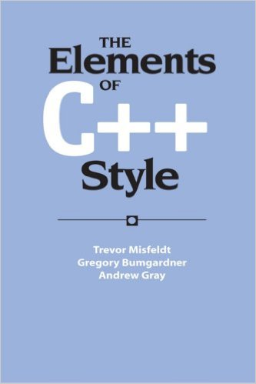
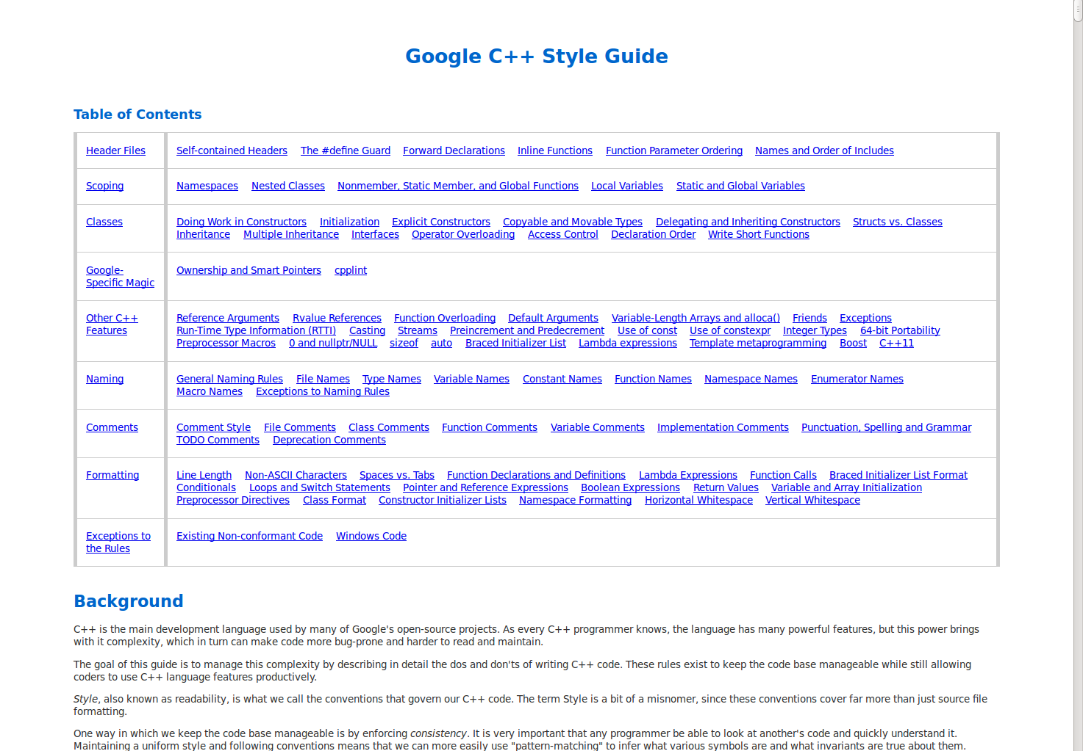
Programming Style
Using a coding style and applying it consistently can be SUPER helpful (particularly to your six-month older self).
This doesn’t have to be onerous or official, but can help readability etc.

Slide 38
Programming Style
Comment, comment, comment:
Always include a comment (indicated by “//”) at the start of the program that states what it does.
Split ideas / blocks of code with blank lines and comments.
Use “inline” comments to refer to equations and meanings of variables.
Indent blocks of code to increase clarity.
Include comments in your data files
(indicated by “#”).

Slide 39
Programming Hints: Debugging
Start simple: develop a routine, test it, develop the next routine, …
Watch for errors during the TPL2CPP phase of the compilation.
Errors during the C++ compiler stage relate to the CPP file and NOT the TPL file.
Use “cout” to output variables to the screen so you can check that the function is being calculated correctly.
Test code by writing out intermediate results (you can then check that the values output are correct given the values for the parameters – the first call of the function will involve the parameters being set to their initial values).
Cross compare: Write critical bits of code in EXCEL or R and check you get the correct values.
Never, ever, ever, believe your code is correct: always work on the assumption there is an error somewhere.

Slide 40
What’s Next?
Maximum Likelihood
Mark-Recapture Experiment
Reading: Cooch & White (2009) Chapter 1

Slide 41
Reading
Fournier, D.A., H.J. Skaug, J. Ancheta, J. Ianelli, A. Magnusson, M.N. Maunder, A. Nielsen, and J. Sibert. 2012. AD Model Builder: using automatic differentiation for statistical inference of highly parameterized complex nonlinear models. Optim. Methods Softw. 27:233-249.

Slide 42
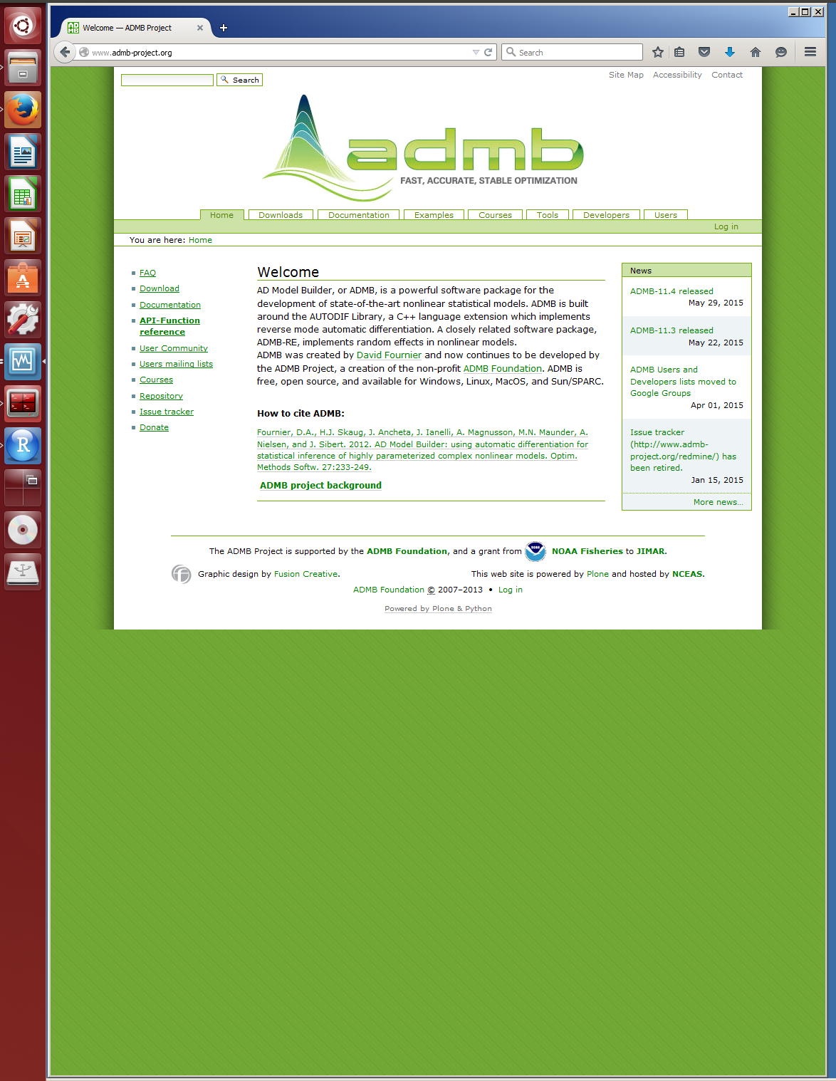
Resources
admb-project.org
Downloads
Documentation
User mailing list
etc.

Slide 43
Additional Resources
Reference Card
http://www.admb-project.org/documentation/refcards

Slide 44
Lab 1 Tips and Traps
Check that your program is reading in the data correctly.
Use ‘cout’s in the DATA_SECTION to check things.
ADMB reads in values from the data file as they are specified (arrays fill in from the right-hand dimension).
Anything declared in the PARAMETER_SECTION, ADMB will calculate derivatives for. Don’t include variables that are purely functions of the data.
In the PARAMETER_SECTION, only use ‘init_’ for the estimated parameters of the model, variables that are functions of the model parameters should be declared without the ‘init_’ prefix.
Dimensions of vectors and matrices need to be declared at both the lower and upper values for each dimension
e.g. vector my_vector(1,10);
//creates a vector called my_vector of length 10 with elements 1 through 10.
e.g. matrix my_matrix(1,10,1,3);
//my_matrix will have 10 rows and 3 columns.

Slide 45
Lab 1 Tips and Traps
ADMB initializes estimated parameters either at zero, or at the mid-point of assigned bounds.
Be careful if taking logs of a parameter that can be zero or negative.
Solutions:
estimate parameters that can only be positive in log-space.
init_number log_a; //in parameter_section
a = mfexp(log_a); //in procedure_section
OR: place bounds on parameters
init_bounded_number a(0.0001,10)
Calculations in the PROCEDURE_SECTION will be performed for each iteration of the parameter vector.
Good practice to only include necessary calculations here.
Exception: a derived variable that you want ADMB to compute standard errors for; declare in the PARAMETER_SECTION using ‘sdreport_’ variables. e.g. sdreport_vector my_vector(1,npar);
Don’t assign values to estimated parameters in the PROCEDURE_SECTION.
Indexing! Be careful. Indexing can sometimes get confusing.
Although inelegant, for loops can be very useful in terms of stepping through calculations; get program to work first, then optimize.
If subject is a vector of integers, subject = c(1,1,1,2,2,2)
a(subject) will return a vector of length subject c( a(1),a(1),a(1),a(2),a(2),a(2) )

Slide 46
Lab 1 Tips and Traps
Check the output that is written to screen! Don’t assume that your model is correct just because it compiles and runs.
Making your program generalizable
(single or multiple intercept parameters)
A vector can be length 1.
e.g. init_vector ln_a(1,num_par)
This is OK even if num_par =1
Possible solutions:
Read in the subject for each data point
For 1 parameter either read in a vector of 1’s or set to 1 in the model internally.
init_int num_par; //DATA_SECTION
init_ivector subject(1,ndata); //DATA_SECTION
if (numpar==1) subject=1; //before the procedure section
ln_weight = ln_a(subject) + b*ln_length; //predicted values

